Slide 1


MEASI COLLEGE OF EDUCATION

Slide 2
KNOWLEDGE AND CURRICULUM
UNIT - I
EPISTEMOLOGICAL BASES OF EDUCATION - Part II
Presented by
Dr. N.M.SUNEETHA,
ASSISTANT PROFESSOR
MEASI COLLEGE OF EDUCATION

Slide 3
Epistemological Questions:
What is Knowledge?
2. How is knowledge acquired?
3. What do people know?
4. What are the three conceptions of knowledge?
5. What are the different types of knowledge?

Slide 4
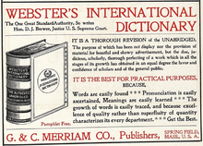
KNOWLEDGE
According to Webster’s Dictionary, Knowledge is “The fact or condition of knowing something with familiarity gained through experience or association. This knowledge is specific to the entity which created it.”

Slide 5
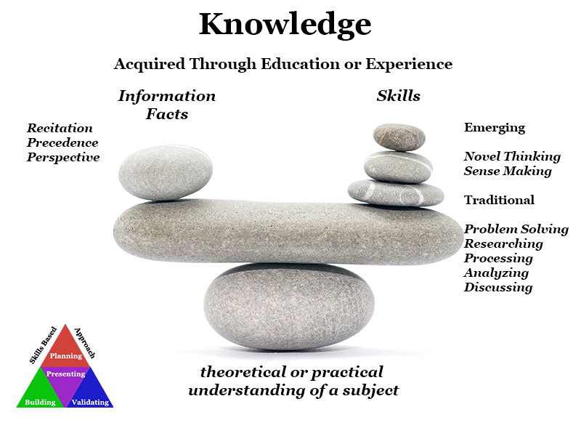

Slide 6
Conceptions of KNOWLEDGE
KNOWLEDGE FOR PRACTICE
KNOWLEDGE IN PRACTICE
Epistemelogical Conceptions
KNOWLEDGE OF PRACTICE

Slide 7
Types of knowledge
Apriori
Vs.
Aposteriori
Explicit
Vs.
Tacit
Propositional
Vs.
Non-propositional

Slide 8
Place your screenshot here
Epistemological Bases of Education

Slide 9
ETYMOLOGICAL MEANING OF EDUCATION
According to one view ‘Education’ is originated from the Latin word ‘Educare’ which means ‘ to bring up’ or ‘ to nourish’ .
There is another derivation from the Latin word ‘Educere’ which means growth from within.
It is in this latter sense that most of the modern educationists use and imply the term ‘education’ these days.

Slide 10
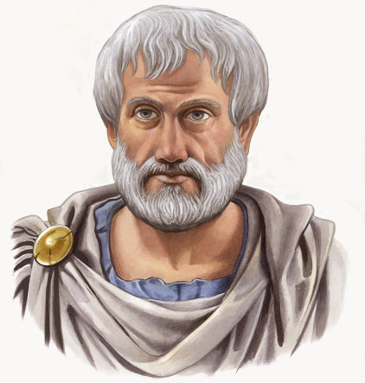
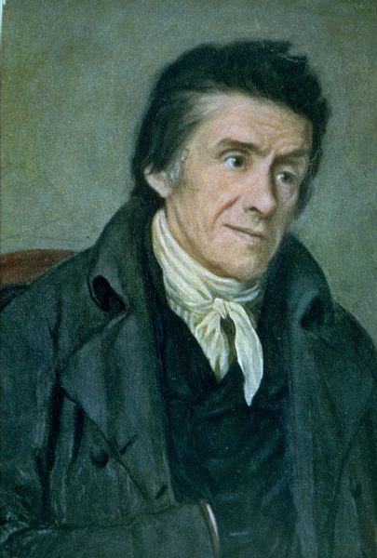
Education to Western Philosophers
Aristotle:
Education is the creation of a sound mind in a sound body.
Pestalozzi:
Education is natural, harmonious and progressive development of man’s innate powers.

Slide 11
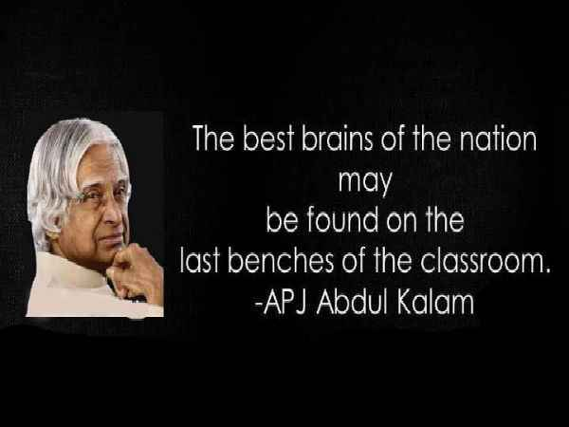
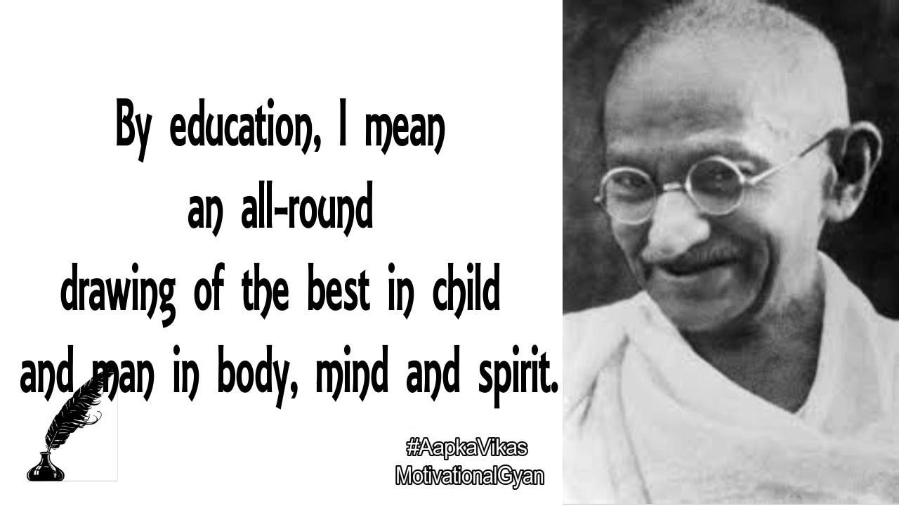
Education to Indian Philosophers
“Education is the most powerful weapon which you can use to change the world.” – Dr.APJ. Abdul Kalam

Slide 12
Education and important terms in it
Teaching
Learning
Skills
Reasoning (Inductive and Deductive)
Training
Data and Information
Belief

Slide 13
Place your screenshot here
SOME IMPORTANT TERMS IN EDUCATION

Slide 14
1. TEACHING
“A profession of a group called teachers or the activities of a group (known as teachers) undertaken to help an individual to acquire knowledge, skills, attitudes and values.”
However the concept of teaching is not that simple. It is a very complex social, cultural and ethical process designed in a social or cultural context.

Slide 15
Nature and characteristics of teaching
To provide guidance and training.
Interaction
An art to giving knowledge
A science to educate fact and causes
Continuing process
Encourages students to learn more
Formal as well as informal
Communication of information to students

Slide 16
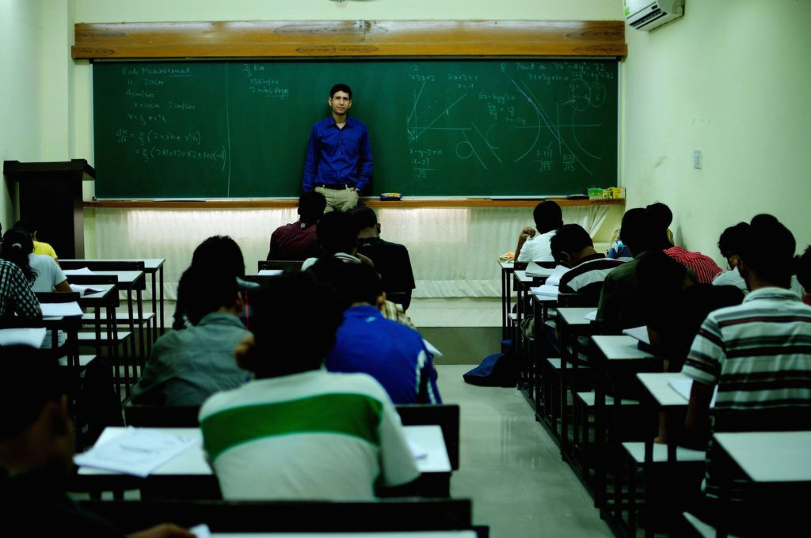
TYPICAL CLASSROOM
Here we can see the social and cultural process of teaching in the social and cultural context.

Slide 17
2. LEARNING
Psychologists define learning as “a relatively permanent change in behaviour, which occurs as a result of activity, training, practice or experience”.
It could be defined more simply as ‘profiting from experience’.

Slide 18
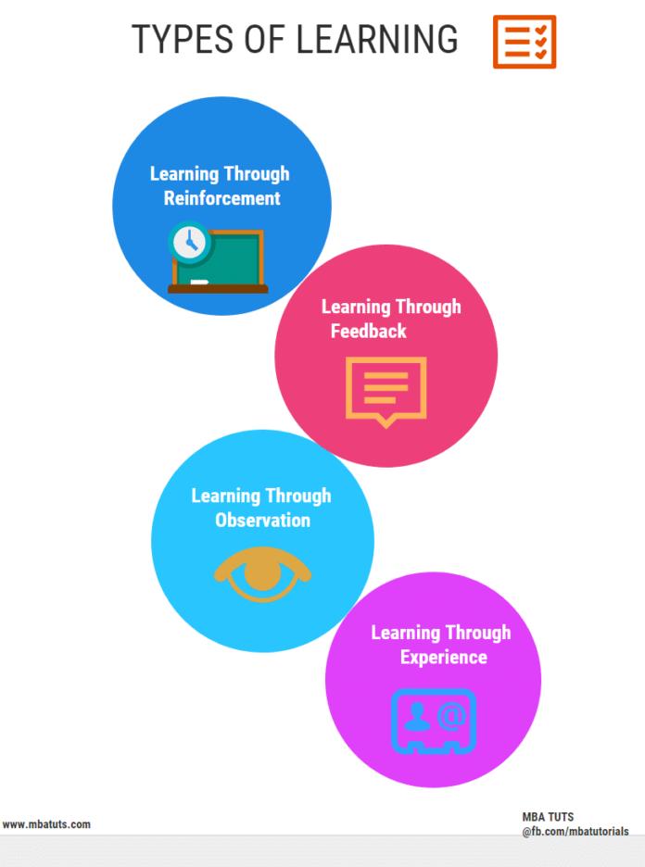

Slide 19
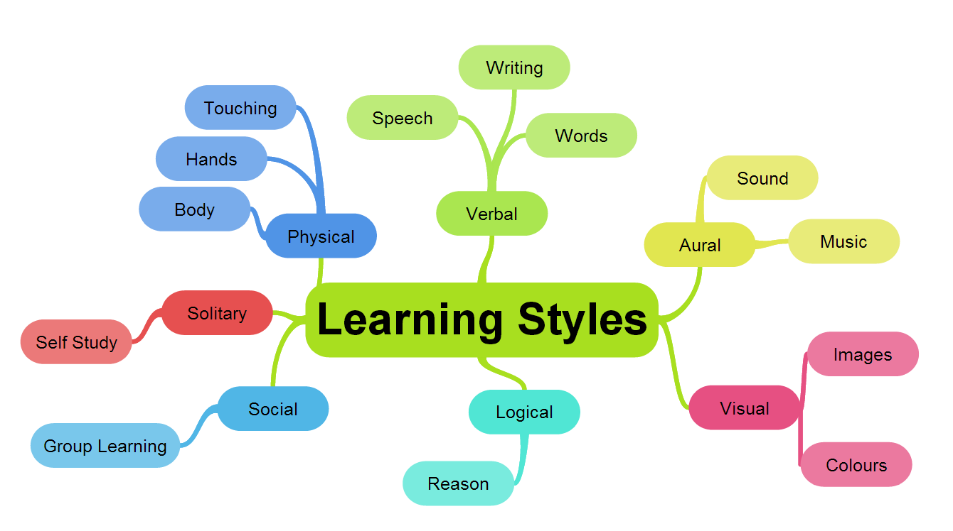

Slide 20
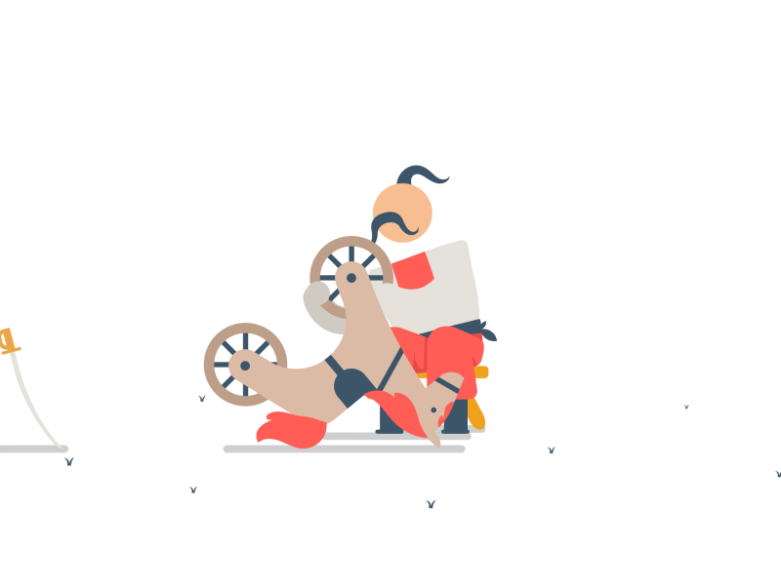
3. SKILLS
Ability and capacity acquired through deliberate, systematic and sustained effort to smoothly and adaptively carry out complex activities or job functions involving ideas (cognitive skills), things (technical skills), and / or people (interpersonal skills).

Slide 21
Teaching skills involve four stages:
OBSERVING
IMITATING
PRACTISING
ADAPTING
This involves two factors- controlling and coordinating.

Slide 22
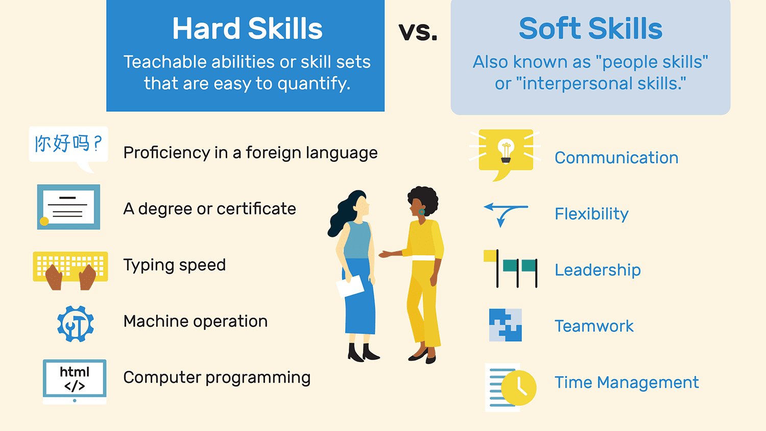
Types of Skills

Slide 23
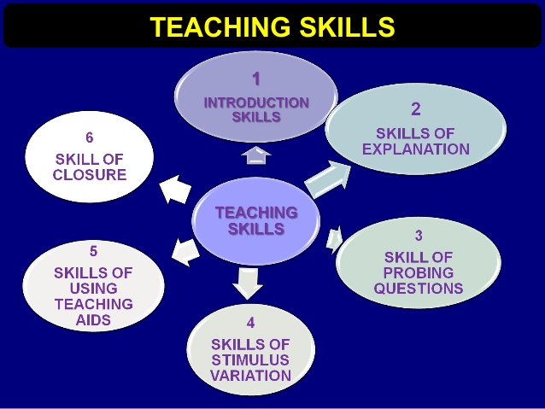
Micro Skills

Slide 24
Required Behavioural Characteristics to learn a skill
Impulsion to perform a particular act
Manipulation of muscle movements to perform such act
Control i.e. incorporating the needed adjustments in any of the tiny acts constituting the skill
Coordination i.e. integrating muscle movements sequentially to perform a particular act and
Naturalisation i.e. while performing a particular act sequentially and fast, performance will be natural, there will be no artificiality in it

Slide 25
4. TRAINING
Training is little higher level of teaching than conditioning.
It helps in shaping conduct and developing skills.
Example:
Training to a worker
Training to an animal in a circus
This kind of teaching aims to develop skilful performance of jobs mechanically is called training.

Slide 26
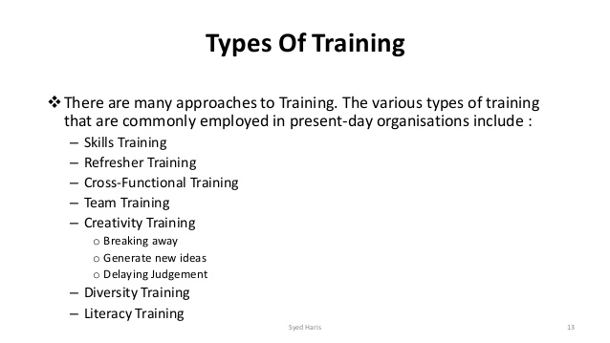

Slide 27
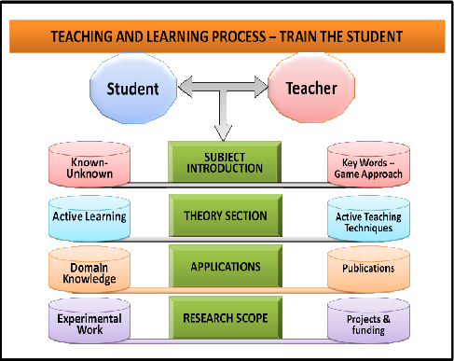
How to train the student?

Slide 28

3) When a set of ‘datum’ is assembled, it may indicate an attribute of a thing or a person.
5 A. DATA
1) Sense perceptions regarding objects, persons or events are recorded in the mind in the form of data.
2) Each small bit of information about a thing, recorded in the mind is called ‘datum’.

Slide 29
5 B. INFORMATION
Information refers to data that has been given some meaning by way of relation/connection
In computing terms, it is the data that has been processed.
Example:
The passbook of a savings bank account.
The data are arranged sequentially with a purpose it reveals some meaningful information.

Slide 30
6. REASONING
‘Reasoning’ as a noun:
taken to mean the cause of an event or a behaviour.
‘Reasoning’ as a verb:
application of logical principles to get at the true nature of the objects or events.
Putting in short, reasoning can be taken to mean analysing rationally and is an important attribute of human thinking.

Slide 31
REASONING PROCESS
It is mostly directed towards getting at certain definite conclusions and inferences.
The laws of logical reasoning must be correctly applied in finding different relationships that arise from the different groupings.

Slide 32
Examples of Good Reasoning:
All men are mortal.
Socrates is mortal.
Therefore Socrates is mortal.
II. No man is perfect.
All scholars are men.
Therefore No scholar is perfect.

Slide 33
Summing up
Reasoning is reorganising and combining our experiences and ideas in new ways using the rules of logic, to judge the correct solution of the problem which confronts us.
So reasoning is a tool in ‘Problem solving’.
It adopts both the inductive and deductive methods in making judgements.

Slide 34
INDUCTIVE REASONING
(the process of inferring the unknown from the known facts)
It involves the process of comparing and combining the individual data obtained (or the various experiences acquired) so as to infer from them a more generalised rule or principle.
Examples:
i. Dilute Sulphuric acid +Zinc Zinc sulphate + Hydrogen gas
ii. Dilute Nitric acid + Copper Cupric Nitrate + Hydrogen gas
iii. Dilute Hydrochloric acid + Silver Silver chloride + Hydrogen gas
“All metals react with dilute inorganic acids to liberate hydrogen”.

Slide 35
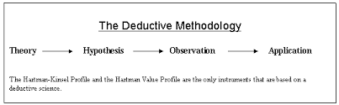
DEDUCTIVE REASONING
A hypothesis or a general principle inferred by inductive
reasoning is subjected to verification in a particular instance to
know its truthfulness which is otherwise called ‘deduction’.

Slide 36
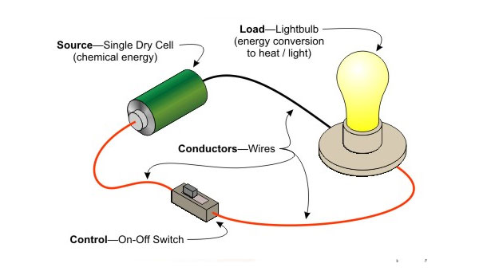
Example of Deductive Reasoning
To establish the validity of the general principle “All metals are good conductors of electricity”.
We can connect a battery, a small bulb and liquid mercury in series so as to complete the electric circuit.
If the bulb glows, then it provides that electricity passes through mercury. (which is the only metal in the form of liquid) which validates the stated general principle.
This process of verifying the truthfulness of a general statement by subjecting it to verification in a particular instance is called deduction.

Slide 37
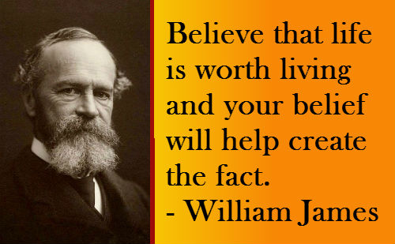

Slide 38
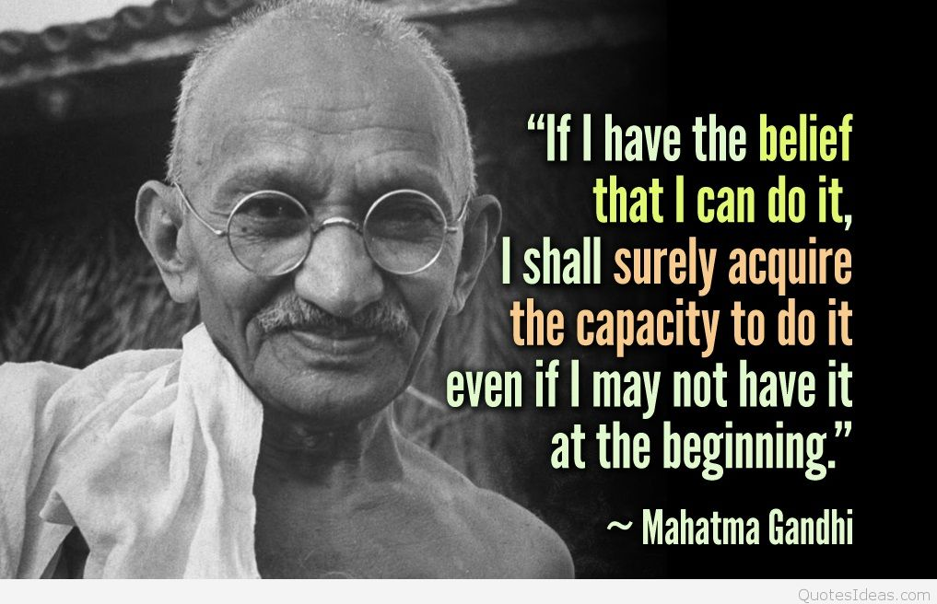
It is an acceptance of something as true, even in the absence of proof.
Example : Belief in God
One may change his beliefs when some proof is obtained that go against his belief.
Accepting of something blindly as true without being ready to examine the evidences is called “wrong beliefs”.
In the absence of evidences, beliefs are taken to be true.
7. BELIEF

Slide 39
Questions for Reflection
What do you know about the meaning of ‘Education’?
Give the meaning of ‘Teaching’.
Write the meaning of ‘Skills’.
What is ‘Training’?
How do you differentiate ‘Teaching’ from ‘Training’?
What do you know about ‘Data’ and ‘Information’?

Slide 40
Questions for Reflection
What do you know about ‘Reasoning’?
Differentiate between “Inductive Reasoning” and “Deductive Reasoning”.
Conduct an experiment which proves ‘Deductive Reasoning’.

Slide 41
Assignment for Unit-I
1. Explain the three epistemological conceptions and important types of knowledge?
2. Discuss the process of ‘Reasoning’ with the differences between ‘Inductive Reasoning’ and ‘Deductive Reasoning’ and also with appropriate examples.

Slide 42
THANK you!

